Slide 1
Discussion 05:
Trees, List Mutation, Nonlocal
Jennifer Tsui
jentsui.github.io

Slide 2
Announcements
Maps due tonight
HW 4 due Friday
Guerrilla Section this Sat 12-2 Soda 271

Slide 3
links.cs61a.org
Password:

Slide 4
Identity
lst1 = [1,2]
lst2 = [1,2]
lst1 and lst2 have the same elements, but they point to different list objects!

Slide 5
Checking if 2 lists are the same
lst1 = [1,2]
lst2 = [1,2]
lst1 == lst2 | lst1 is lst2
Checks for equality Do they have the same elements? | Checks for identity Do they point to the same list object?

Slide 6
Checking if 2 lists are the same
lst1 = [1,2]
lst2 = [1,2]
lst1 == lst2 | lst1 is lst2
Checks for equality Do they have the same elements? | Checks for identity Do they point to the same list object?
True | False

Slide 7
Try
lst1 = [1, 2]
lst2 = lst1
Question 1: lst1 == lst2
Question 2: lst1 is lst2

Slide 8
Try
lst1 = [1, 2]
lst2 = lst1
Question 1: lst1 == lst2
True
Question 2: lst1 is lst2
True
Note: lst2 is not a copy of lst1. If lst1 changes, so will lst2!

Slide 9
Copying a List
lst1 = lst2 DOES NOT copy a list
Instead, we can do:
lst1 = [1,2]
lst2 = lst1[:]
or lst2 = [elem for elem in lst1]
(These operations create a new list)

Slide 10
Try
a = [1, 2]
b = [3, a]
c = b[:]

Slide 11
Try
a = [1, 2]
b = [3, a]
c = b[:]
List splicing creates a shallow copy
c[1] refers to the list that a refers to
we don’t make a copy of the nested list [1, 2]
we copy what is literally in each box (in this case, an arrow to the list that a refers to)

Slide 12
List Operations
Create a New List
list splicing
list comprehension
Mutate original list

Slide 13
Mutating a List
lst1 = [1,2]
lst2 = lst1
lst1[0] = 5
What is lst1?
What is lst2?
lst1 and lst2 are both [5, 2]

Slide 14
Mutating a List
Operation | What it does | Return Value | Practice
append(elem) | Adds 1 box to end of list, puts elem in that box | None | a = [1,2] b = [3,4] c = a.append(b)
Draw box and pointer diagrams!

Slide 15
Mutating a List
Operation | What it does | Return Value | Practice
extend(sequence) | Iterates through elements of sequence, adding each element to end of list | None | a = [1,2] b = [3,4] a.extend(b) a.extend(5)
Draw box and pointer diagrams!

Slide 16
Mutating a List
Operation | What it does | Return Value | Practice
pop(index) pop() | Removes element at provided index. If no index specified, removes last element | The removed item | a = [1, 2] b = [3, a] x = b.pop()
Draw box and pointer diagrams!

Slide 17
Mutating a List
Operation | What it does | Return Value | Practice
remove(elem) | Removes first occurrence of elem. Errors if elem does not exist. | None | a = [1, 2, 1] a.remove(1) a == [2, 1]
insert(index, elem) | Inserts elem at the provided index. (Adds a new value rather than replacing existing value) | None | a = [1, 2, 1] a.insert(1, 5) a == [1, 5, 2, 1]

Slide 18
Adding Lists
lst1 = lst1 + lst2
This creates a new list
a = [1, 2]
b = a
a = a + [3]
After this, b is [1, 2]
lst1 += lst2
This mutates lst1
a = [1, 2]
b = a
a += [3]
After this, b is [1, 2, 3]

Slide 19
Summary: Operations on Lists
Create a new List:
List splicing
List comprehensions
lst1 = lst1 + lst2
list([1,2,3])
Mutate the original list:
lst[0] = 5
Append
Extend
Pop
Remove
Insert
lst1 += lst2

Slide 20
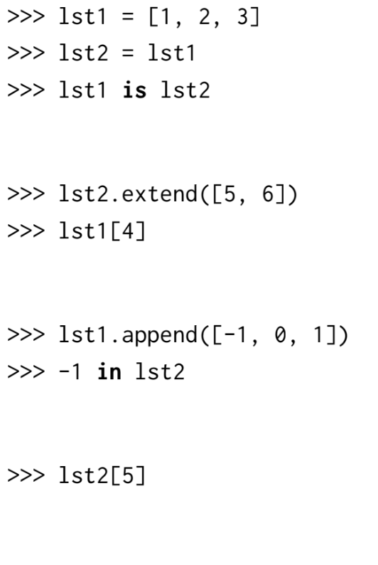
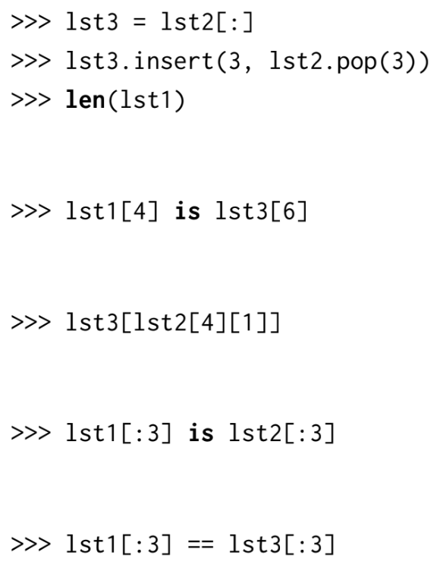
Do Q1.1 on pg. 2 (Draw box-and-pointer diagram!)

Slide 21
Nonlocal

Slide 22
What we already know...
Things we can do:
Access a name in the current frame.
Access a name in a parent frame if it doesn’t exist in the current frame.
Add a new name to the current frame.
Change a binding in the current frame.

Slide 23
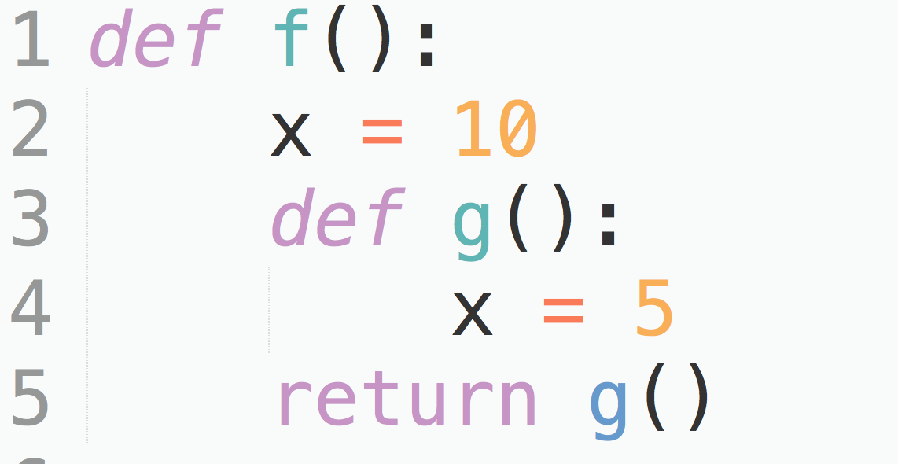
Normally, assignment statement changes value in current frame

Slide 24
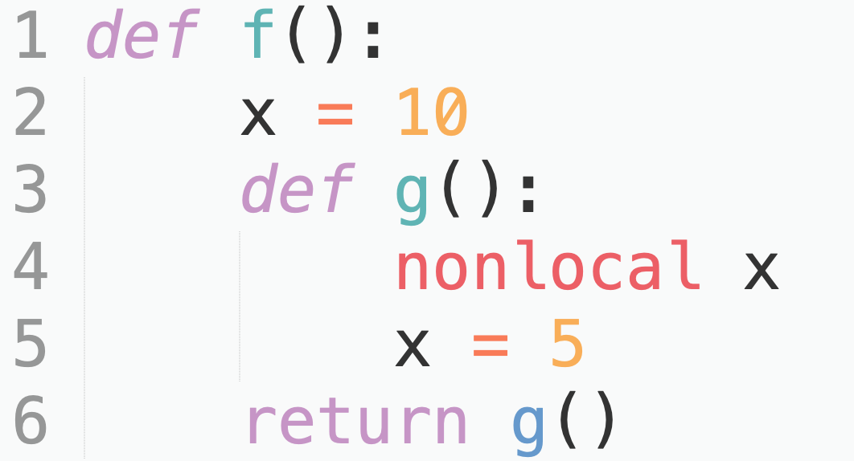
Nonlocal
By default,
you can access variables in parent frames.
you cannot modify variables in parent frames.
nonlocal statements allow you to modify a name in a parent frame instead of creating a new binding in the current frame.
cannot modify variables in current frame
cannot create bindings in parent frames
This nonlocal statement tells Python: “Don’t create a new local variable x; modify the one in the parent frame instead!”

Slide 25
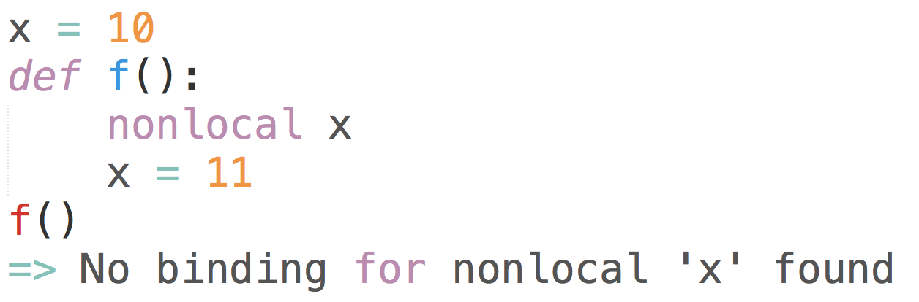
Edge Cases
We don’t look at variables in the global frame

Slide 26
Stepper: Q3.1
Nonlocal name lookup rules:
Look for the name in the current frame’s parent frame first.
If it’s not found, continue looking at parent frames.
1
2 3 4
5 6
7 8 9
def stepper(num):
def step():
nonlocal num
num = num + 1
return num
return step
s = stepper(3)
s()
s()
Nonlocal variable assignment rules:
Use nonlocal name lookup rules to find the binding.
Replace the old binding of the name with the new value.

Slide 27
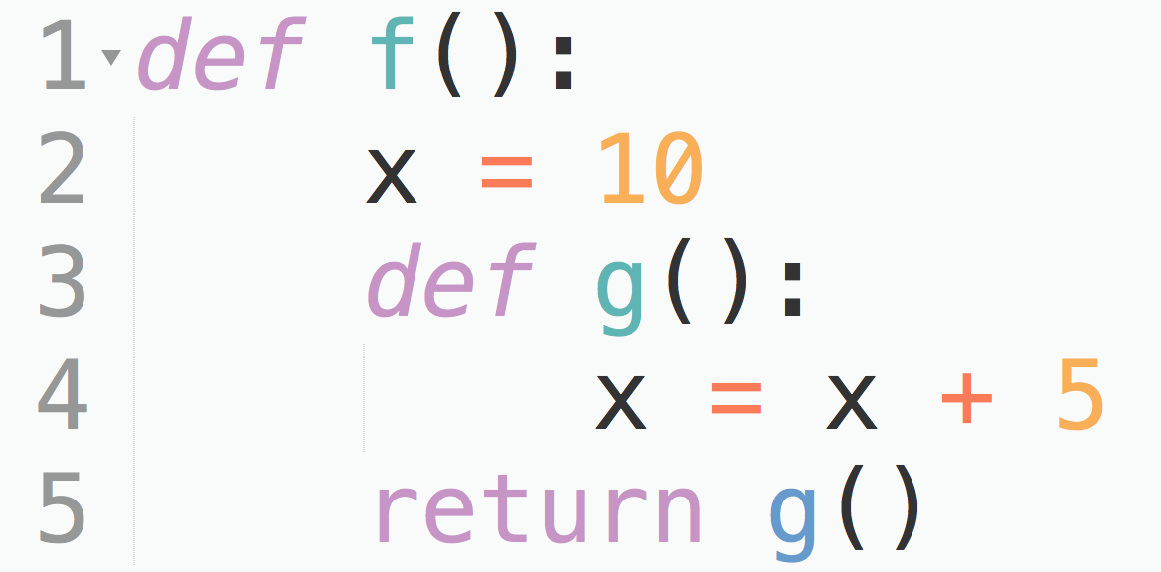
Common error: local variable referenced before assignment
found in current frame
found in parent frame

